Slide 1


AI Section 5: Predictions & Outcomes

Slide 2

Let’s break the ice!
How do you go about guessing if something will work?
“Iceberg Jökulsárlón” by Marco Ottobelli is licensed under CC BY-SA 4.0

Slide 3
Focus Question
In this unit, you will learn how computers make predictions and how statistical math is used to help make predictions using computers
How can we use statistics to help us make better predictions?
Think about how predictions are made:
Historical data?
Guessing?
Evidence?

Slide 4
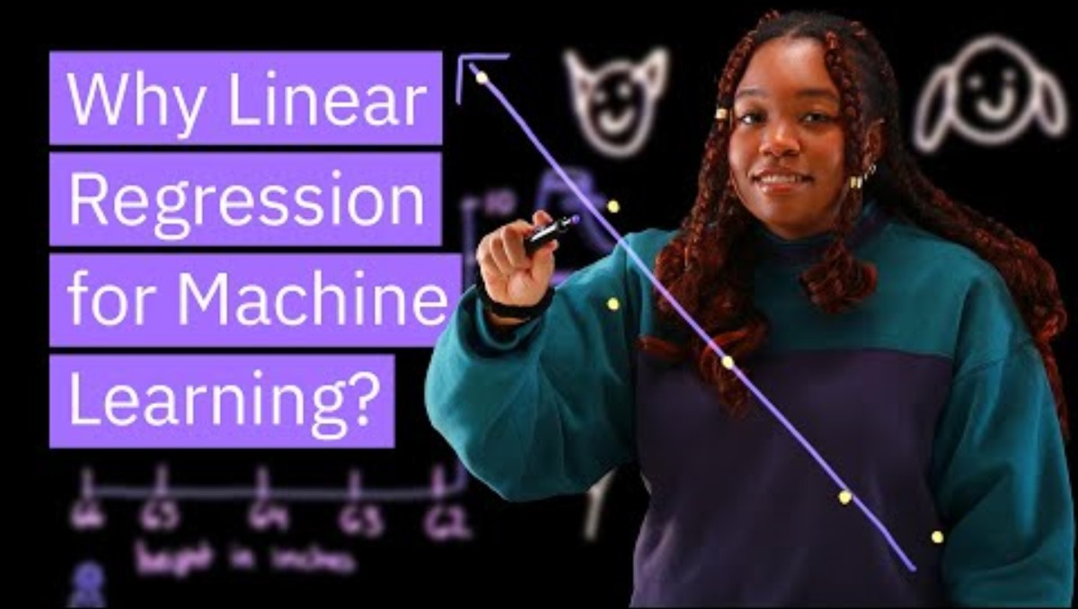
What is Linear Regression?
Watch this video on how linear regression is important for machine learning:
Discuss these questions with your classmates:
Why is linear regression used in machine learning?
What variables and data are they comparing in this video?
Have you ever done linear regression in school?

Slide 5
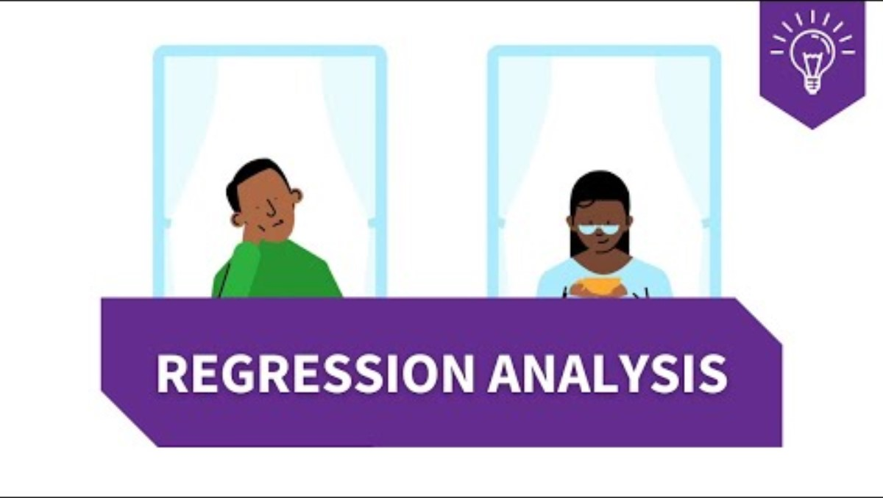
What is Linear Regression?
Watch this video on regression:
Discuss these questions with your classmates:
What is linear regression and what does/can it predict?
What do they do to determine the relationship between the two variables?
What were they predicting here in the video?
What does it mean when they say you have to watch for things that can confound the data?

Slide 6
Linear Regression
What is linear regression?
Linear regression is one of the most commonly used mathematical algorithms to examine the relationship between two variables and is often used to make predictions about things.
You will learn how to do regression first in EXCEL and then in your programming class, you will learn more about how to do this in MATLAB.

Slide 7
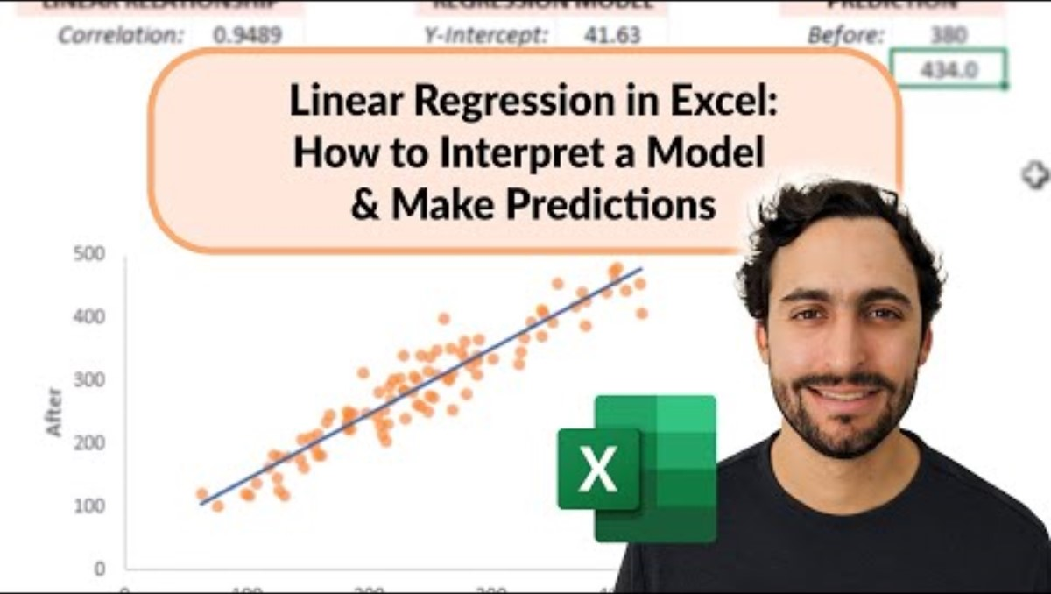
Linear Regression
Watch the video to learn how to do a linear regression in Excel:

Slide 8
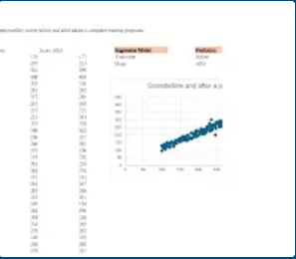
TO DO: Linear Regression
Open the attached EXCEL file of student performance scores.
Rewatch the video and find the line of best fit for the regression. This is done by adding the trendline.
Use this data to run your regression:
Student performance scores.xlsx
(can also be found on Canvas)

Slide 9
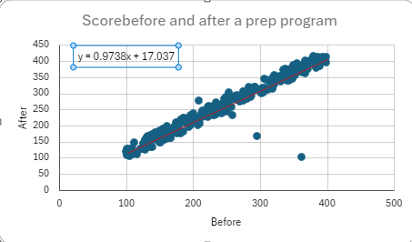
TO DO: Linear Regression
Graph should look something like this:
3. Once you do this, get the equation for the line.
What is the slope? What does the slope mean in terms of the student gain for the employability score before and after the training program?

Slide 10
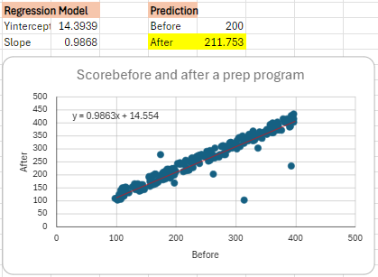
TO DO: Linear Regression
4. Follow the directions to make the regression model and make the prediction based on the before score.
Should be able to see an increase in the score after:

Slide 11

TO DO: Linear Regression
5. Why might a student want to know how much the training program would improve their score before they signed up for the program?
6. Will the program always accurately predict a student's performance after taking the class?

Slide 12
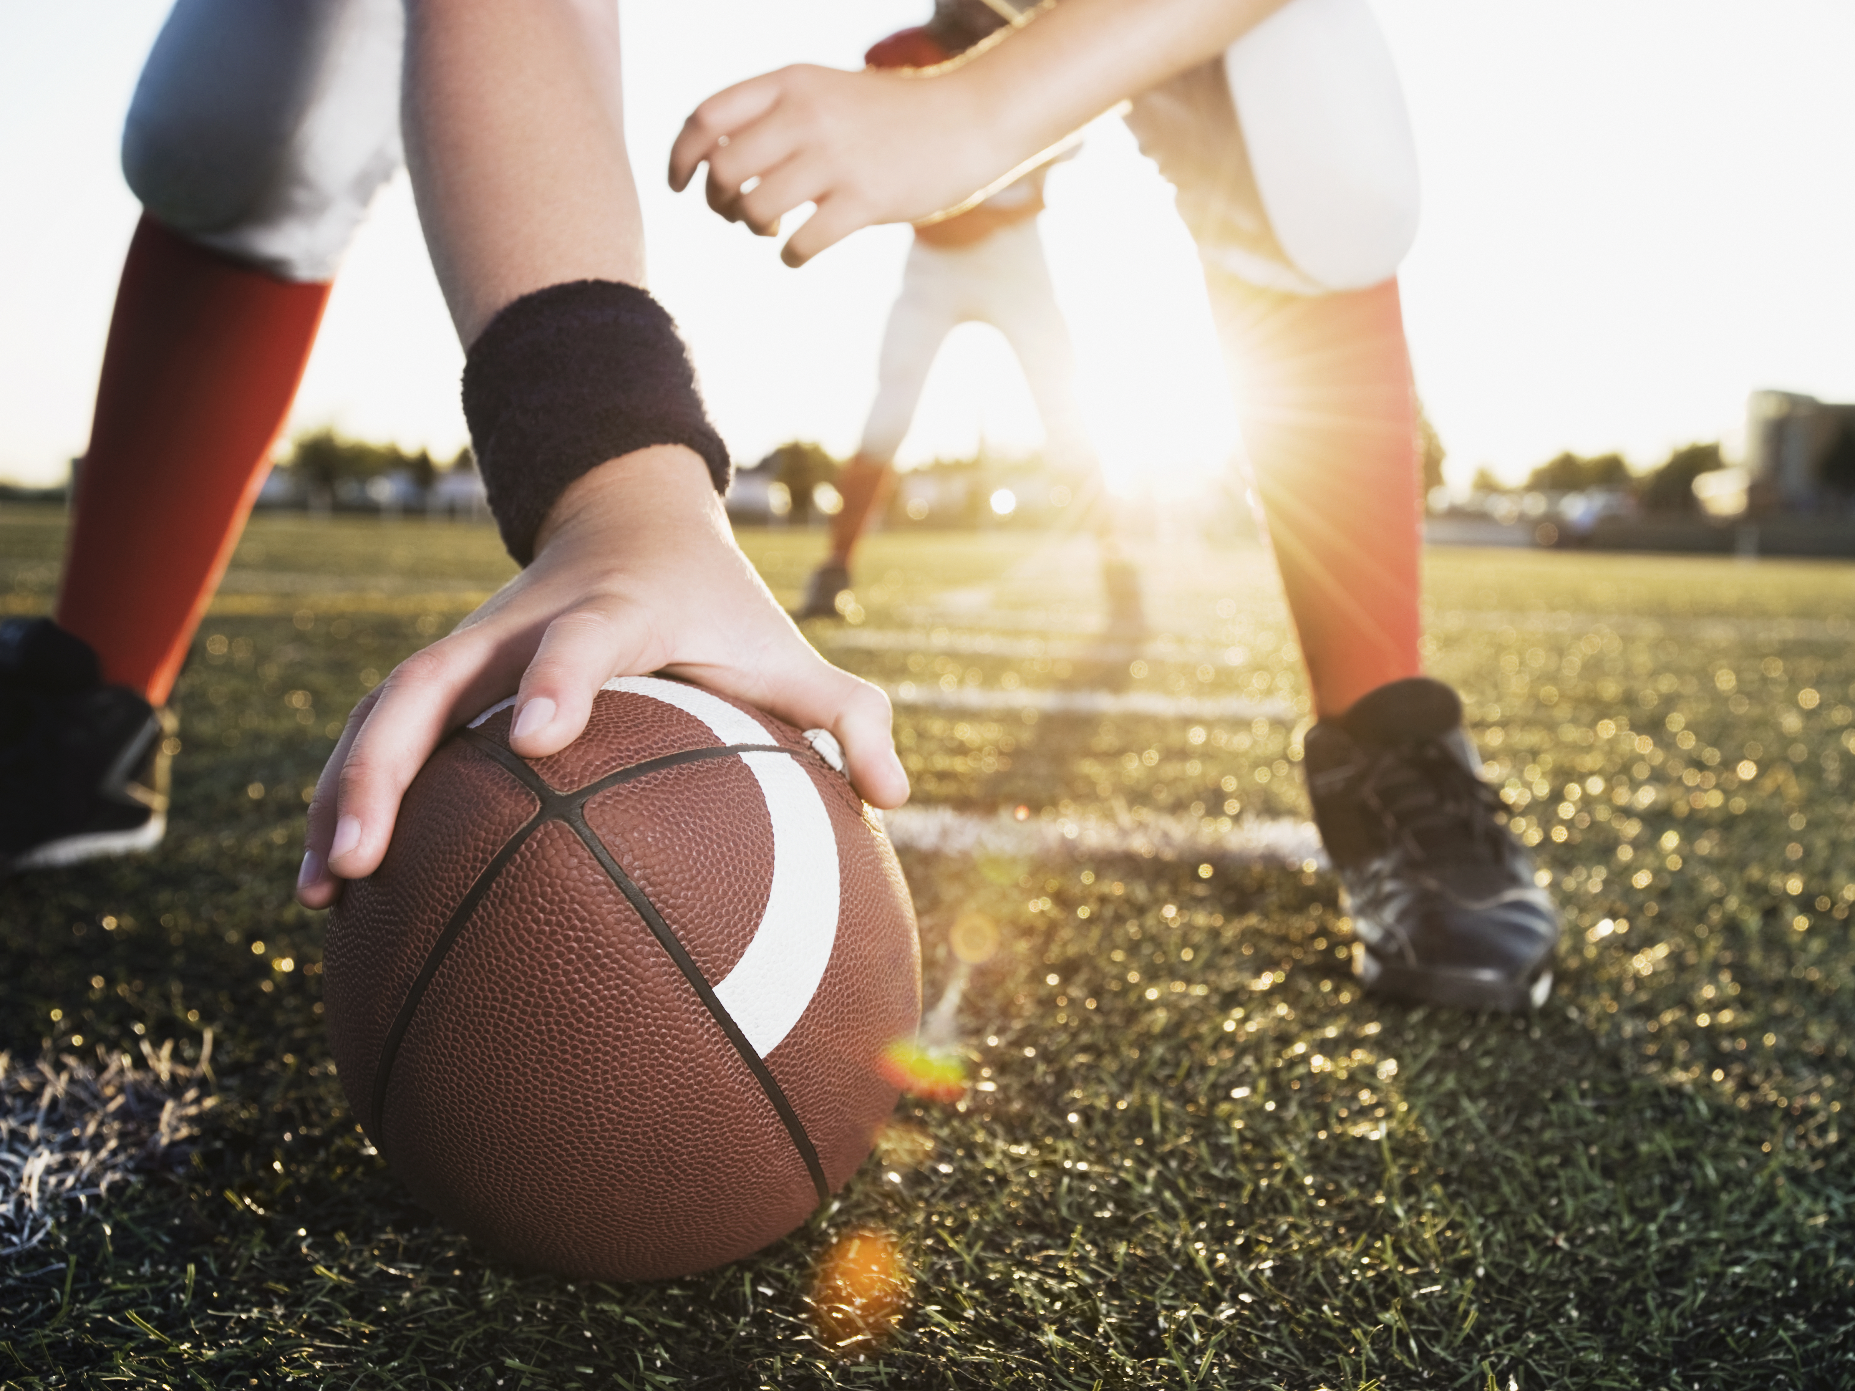
To Do: Sports Analysis
Now we will look at some Sports data.
The file you will use is from pro football - 2023 NFL Advanced Stats | Pro-Football-Reference.com.
We are using the 2023 statistics for passing and receiving data. They are already loaded into the spreadsheet below for you to use.
2023 NFL data stats.xlsx

Slide 13
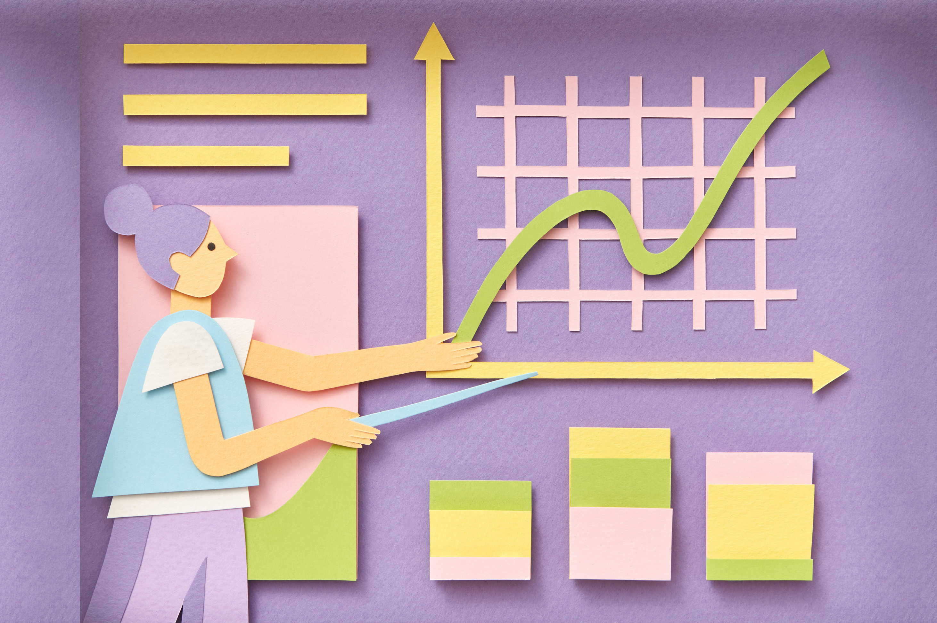
To Do: Sports Analysis
1. What two variables would you think are related and would be good to try and do regression on?
2. Using what you learned in the last spreadsheet, do regression for at least two different comparisons. Decide what two different comparisons you want to make.
3. How well did your regressions turn out? What was your number for the trendline? How well correlated was the data?
4. Why do you think it is important to understand the data in order to be able to use it to make predictions?

Slide 14
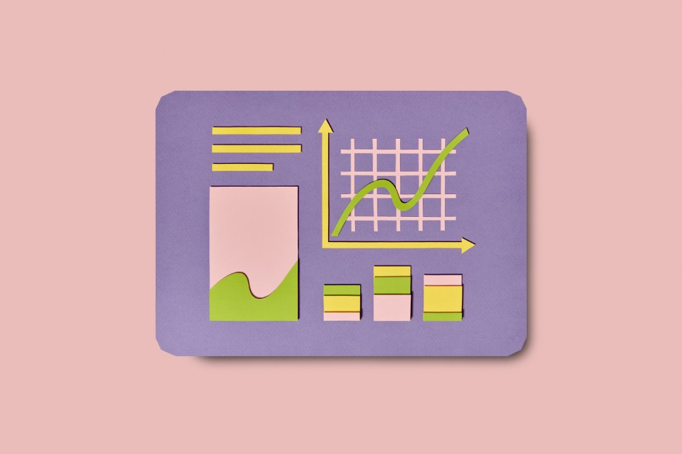
Refine
Think about examples for music artists and what things may be correlated from the music data you looked up in the last lesson.
For either music or sports data - come up with some variables you think could be related and could be analyzed with linear regression.
For example for music- Kodak Black is often in trouble with the law - I could look up his dates of incarceration and see if the number of downloads of his songs goes up (positive correlation) or down (negative correlation) each time he has to go to jail..

